Slide 1
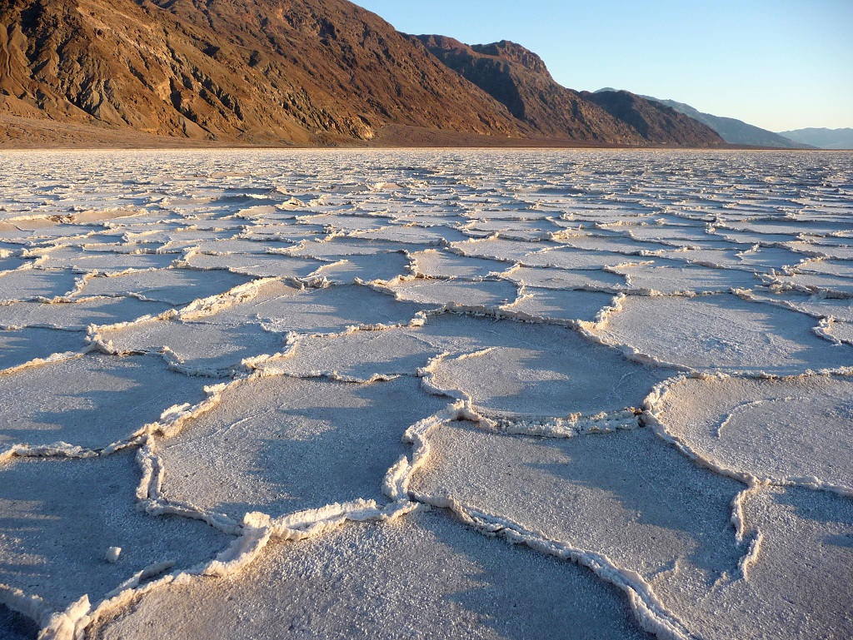

National Park Service
U.S. Department of the Interior
Death Valley National Park
Military Aircraft Crashes
June 2022
NWLT
Notes:
Thank you for opportunity! It’s clear this relationship is taken seriously and is one we value as neighbors
Intro self / Title – 25 years with NPS (1st JPPB) – Intro (himself) Greg
Breaks!
Cherie Head: Add MANZ (Bernadette Johnson) NHS to agenda for next year (overflights may be < 3000 AGL; site is sacred and > 3,000 AGL is distraction)
Andy Corzine / Matt Boggs (Craig Miller & Team great – project moving well - $110k tfer in process for Compliance, engineering in progress)
3) Anna Maria (China Lake) gone (was lead). Clarence Everley (Ft Irwin) still here.

Slide 2
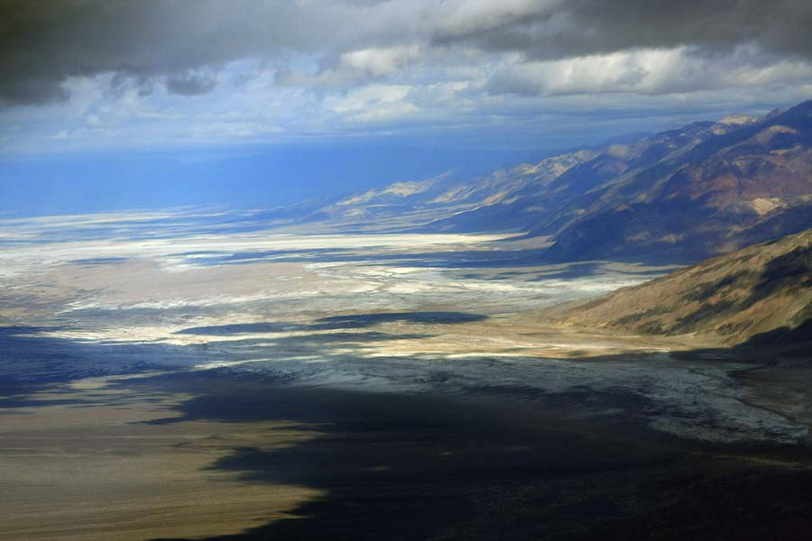
Death Valley
National
Park
(former Monument) lowest, hottest, driest, largest
Notes:
DEVA Overview
Lowest, hottest, driest, largest
8 cgs, hiking, 12 mtn ranges, 282 to 11k, 92% D. Wilderness – largest named in lower 48, year round!
NM vs NP
No Overflights < 3,000 feet AGL over the rest of the park.

Slide 3
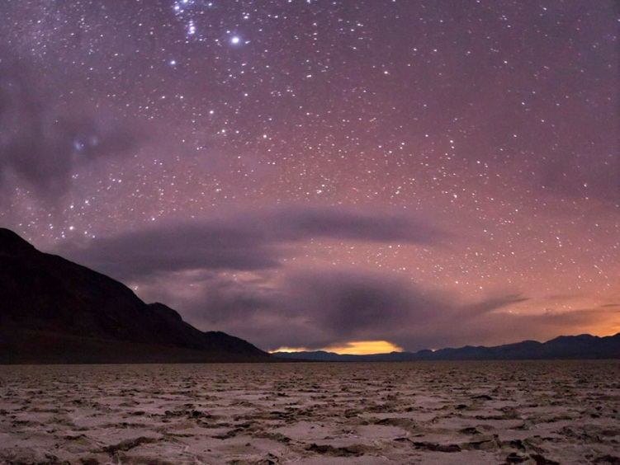
Death Valley
National Park
- established in 1994 as National Park through the California Desert Protection Act
- added 1.5 million acres to park from Monument boundaries
- Created Death Valley Wilderness
-2019 Dingell Act added 35,000 acres to the park along border with Fort Irwin
Notes:
Overflights 200 ft to 3,000 ft AGL – brief history (Creation of DVNP 94 DPA allowed – likely there would be no NP without it – important part of DVNP). Unique to DVNP.
Request is for acknowledgement 200 AGL in NPs (Saline, Panamint & Eureka Valleys – 1/3 of park)
Purpose – visitor understanding given that low level flights are not compatible with typical NP Values, but are part of DEVA. Visitors are confused.
Acknowledge: Shared management / mission “Protect national assets and interests”

Slide 4
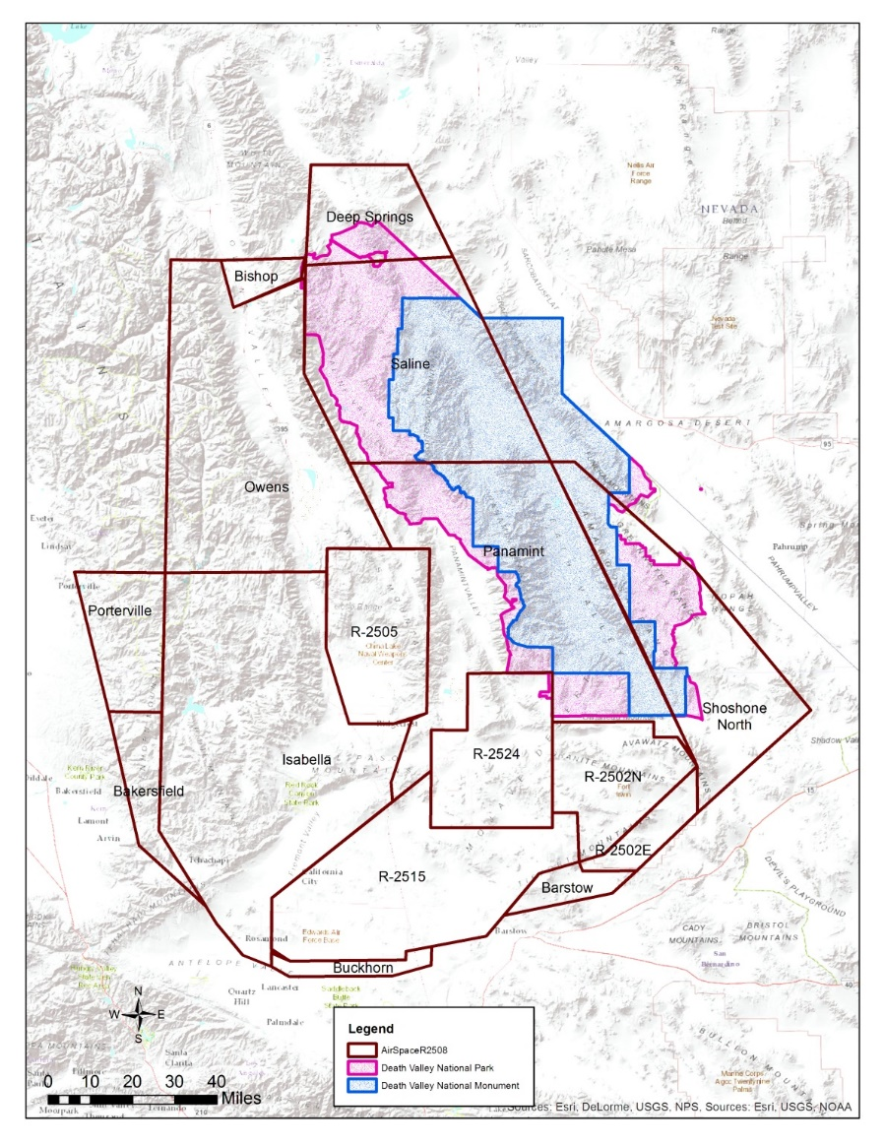
2508 airspace
Airspace used by DOD for a multitude of training and testing.
Most of Death Valley falls under 2508 airspace.
“Monument” boundaries DOD flights down to 3000 feet, rest of park down to 200 AGL.
Low level flights are mostly fighter/attack type aircraft

Slide 5
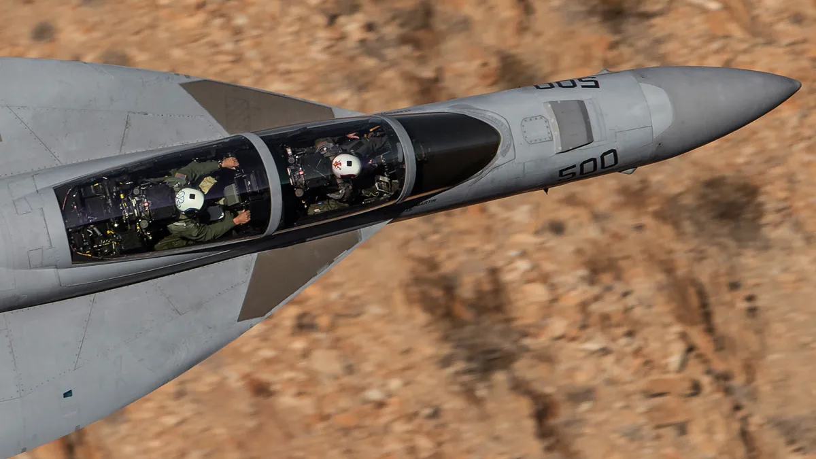
Rainbow Canyon (aka Star Wars)
- several popular viewing areas for low flying aircraft
- social trails and informal parking have developed
Photo taken for internet
Notes:
Overview of R-2508 route through DEVA and high level of visitor interest. 2019 incident, 1 fatality and 7 tourist injured, litigation.

Slide 6
Impacts
Timing of flights was well known am published on the internet; pilots were in contact with photographers through social media
Hundreds of photographers and enthusiast would gather to watch the “air show”
New trails and pullouts created along the road, road congestion on windy mountain road.

Slide 7
Crash
July 2019 F/A 18 crashed into the canyon wall in Rainbow Canyon
Pilot was killed and 7 tourist were burned by the fire ball, 3 requiring treatment at a burn center.
Worked with the Navy extensively on initial recovery, investigation, and site security.
Clean-up took place over the next 7 months by contractor, NPS provided READ for the cleanup effort.
Navy immediately stopped flying through the canyon and the 2508 airspace coordination center closed the canyon July of 2021

Slide 8
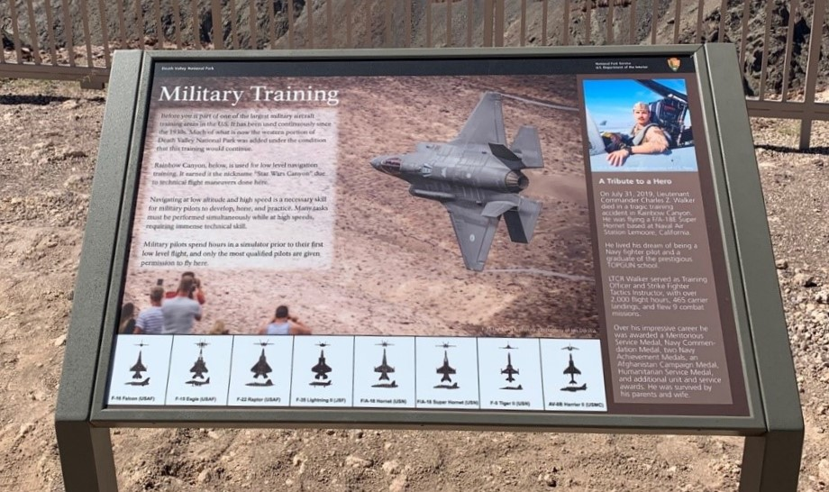
New Plaque at Father Crowley
Notes:
Developed in conjunction with Navy, LCDR Family, and the NPS.
Interprets flight activities in Death Valley as a whole, while commemorating LTCR service.

Slide 9
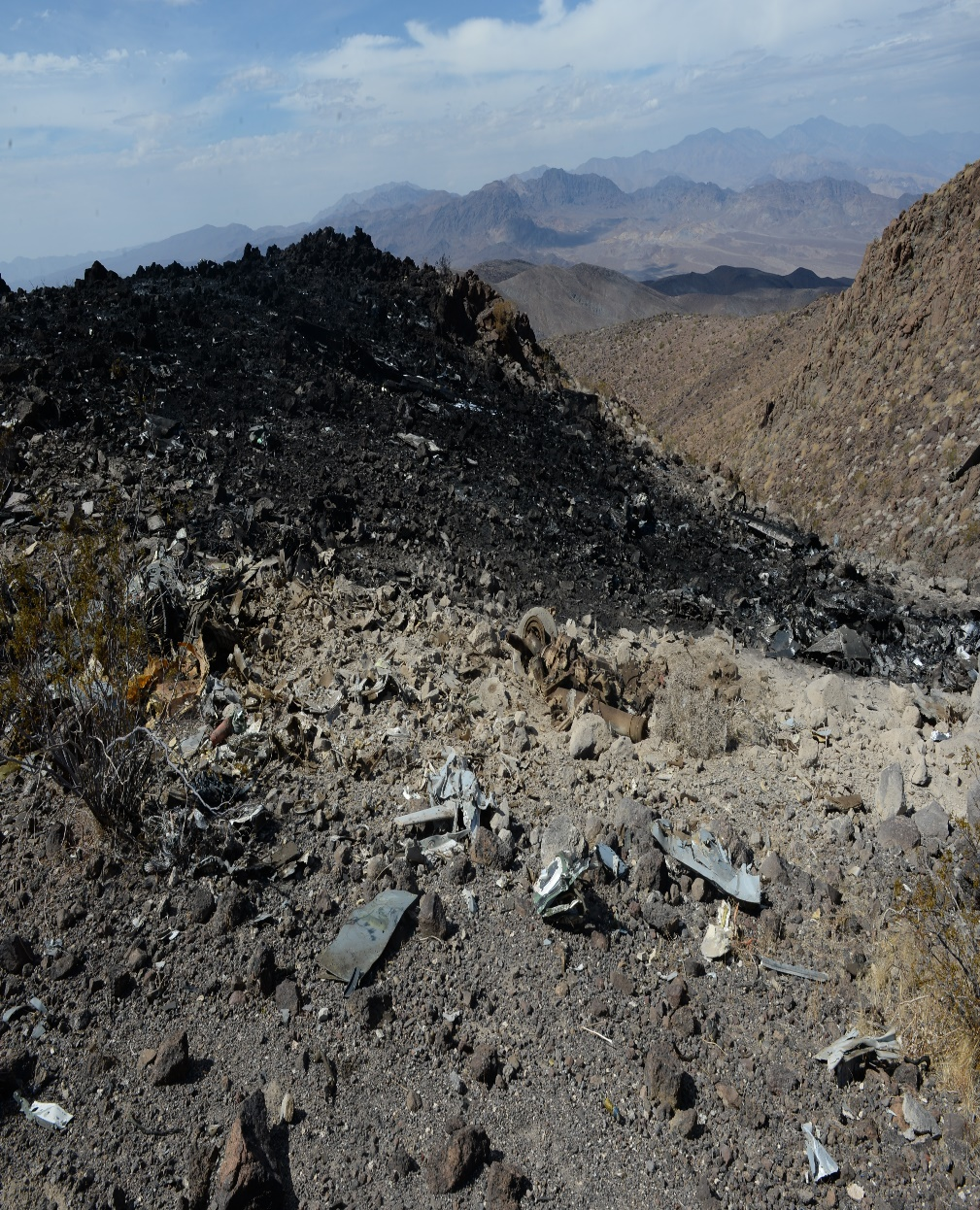
2021 F18 incident
F18 crashed into the remote and roadless Wilderness of Death Valley in the Owlshead Mountains.
Debris and fire causing damage that is still being assessed
NPS and Navy integrated in response from beginning, led to fewer impacts

Slide 10
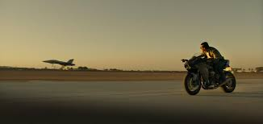

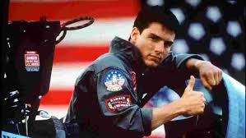
NPS response
Day after incident NPS presence in Navy ICP in China Lake
Worked extensively with Navy command on wilderness issues- helicopter landings, EOD detonation, hazmat stabilization.
Went to the site regularly to assess
NPS RM staff to site

Slide 11


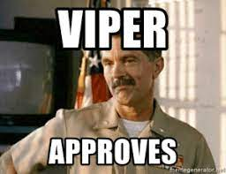
Cont….
Developed relationship with Navy and built up buy in for resource/ Wilderness protection.
Able to communicate in real time needs and requests from Navy to DEVA staff when my comfort zone was exceeded
Provided a real, on the ground picture of the impacts and how to mitigate

Slide 12
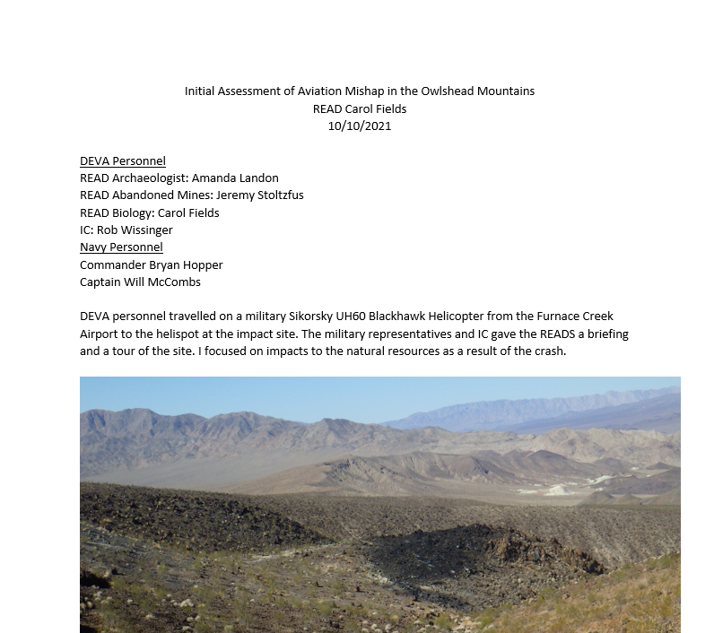
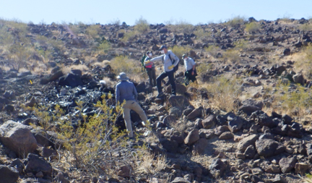
Resource Advisor (READ) assessments

Slide 13
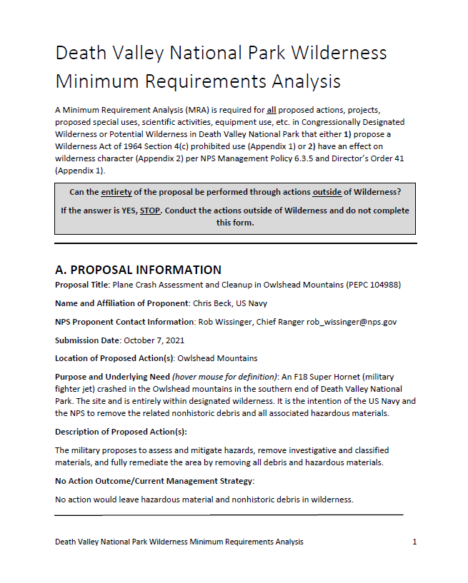
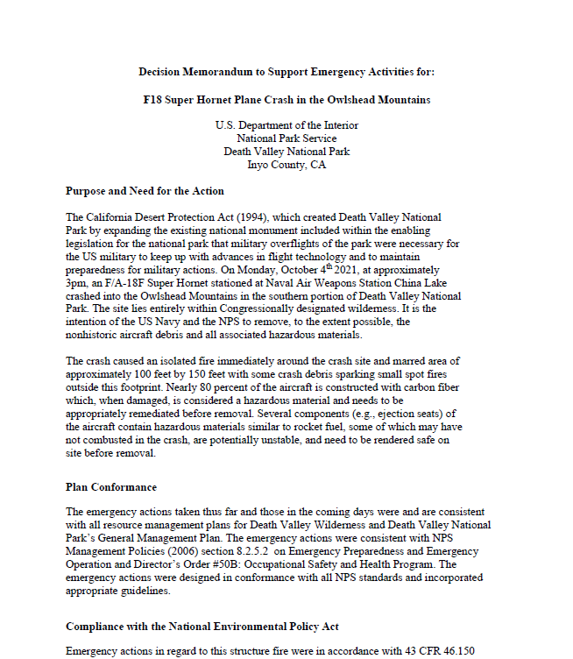
NEPA MTF and MRA

Slide 14
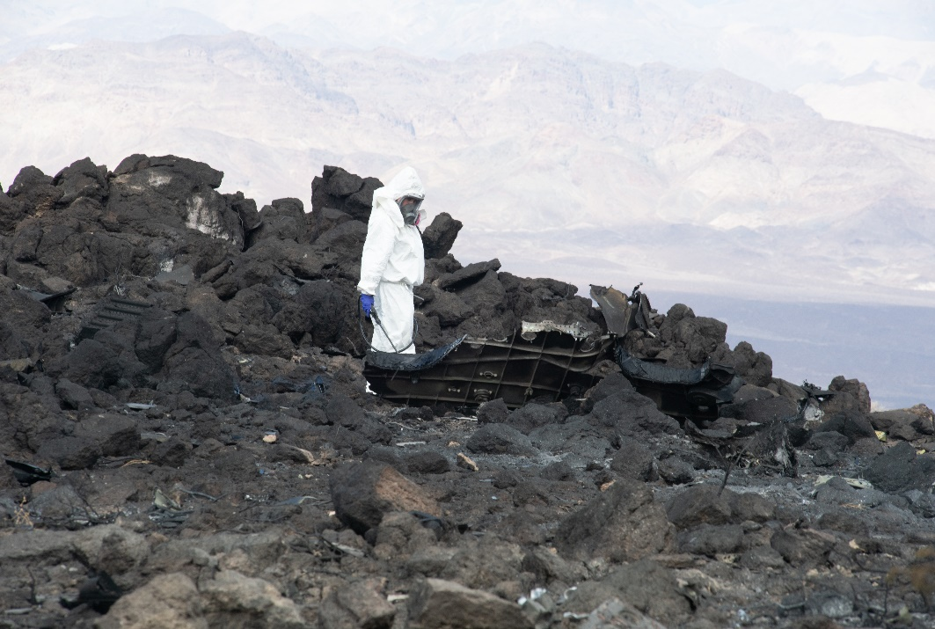
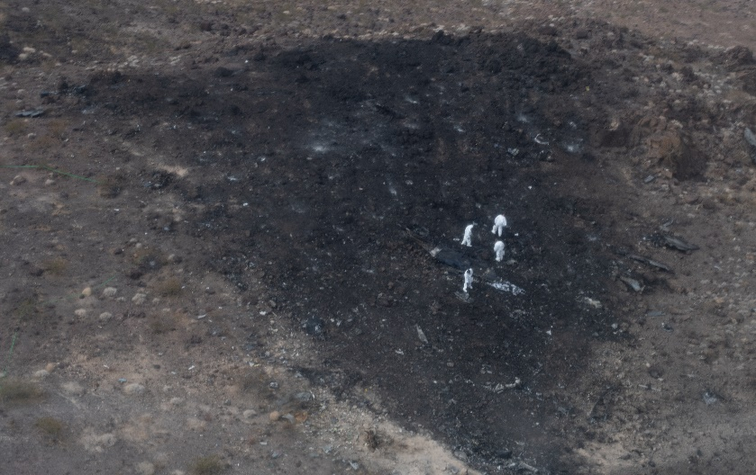
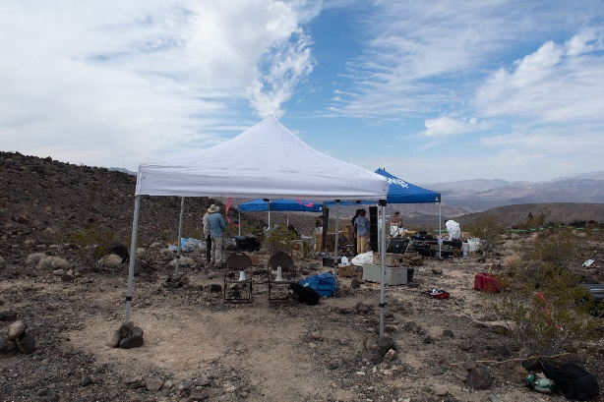
Resource Damage and Mitigations
Specific issues being addressed-
  Soil contaminants
  Scar from Fire
  Large and small debris removed
  Heli spot, trail, and staging site impacts
  Attractive nuisance
Notes:
Attractive nuisance… folk going out there to find it

Slide 15
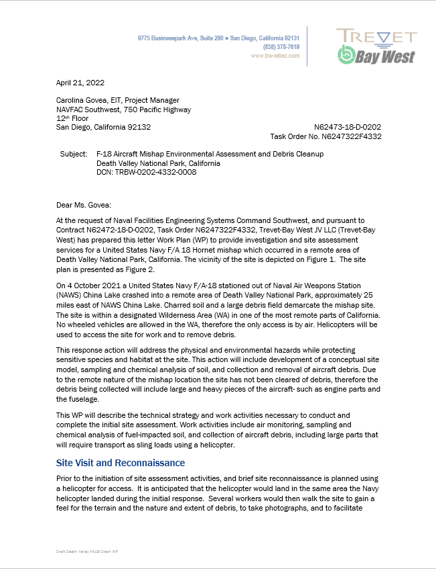
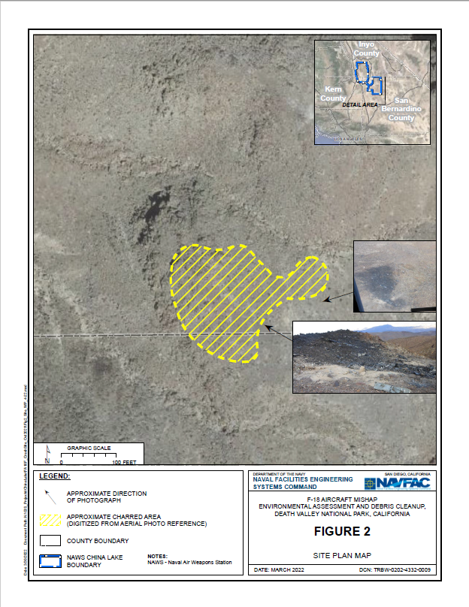
Clean Up

Slide 16
Where we stand today
We have a signed MIPR with the US Navy covering our current and projected costs for the incident
Planning for the clean up- will have NPS READ on sight for duration of the cleanup
Worked with contractors and Navy to assure that aircraft use are minimum impact
Relationship with Navy is stronger than ever before, with new lines of communication

Slide 17
Lessons Learned
Relationships, Relationships, and Relationships
Pick your battles, there has to be give on both sides aim for what will have the greatest positive impact
Phone a friend… and have friends that are smarter than you!
Integrating resource protection into the DOD mission, leveraging a mission driven culture
Debriefing NPS staff each day helped me prepare for the next
Extend trust and positive intent

